Slide 1

Differential Gene Expression Analysis
By: Rodrigo Espinoza – TIGP Bioinformatics PhD Candidate
Advisor: Dr. Hsuan-Yu Chen

Slide 2
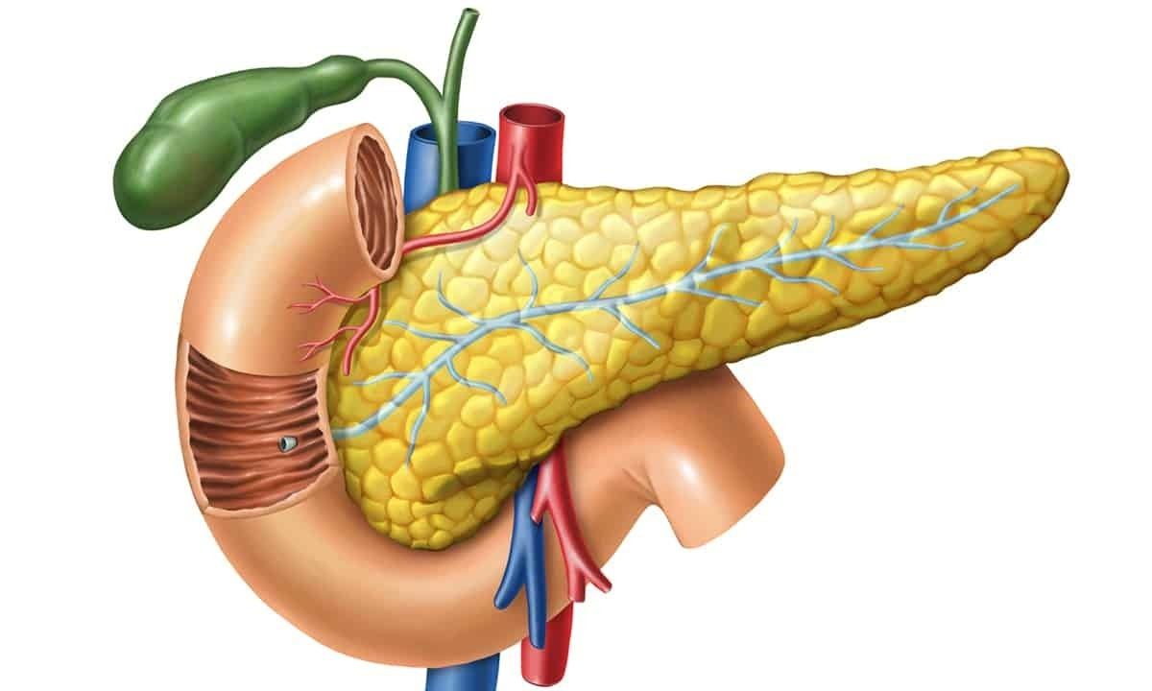
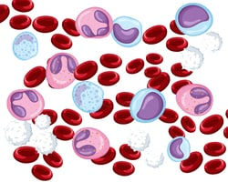
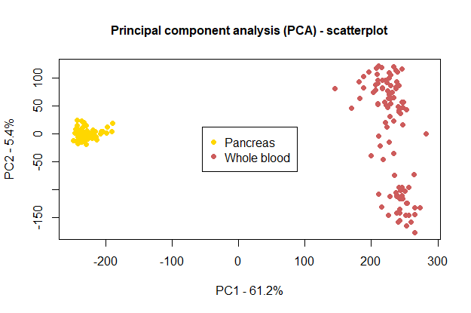
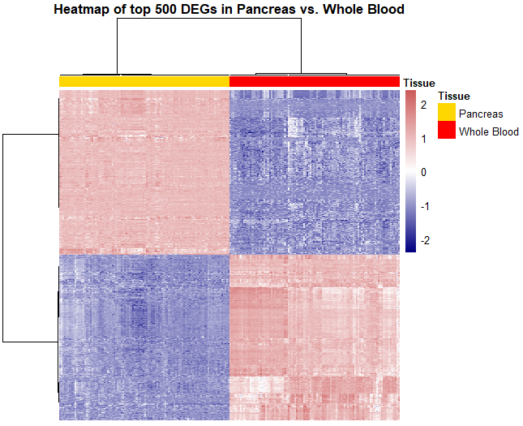
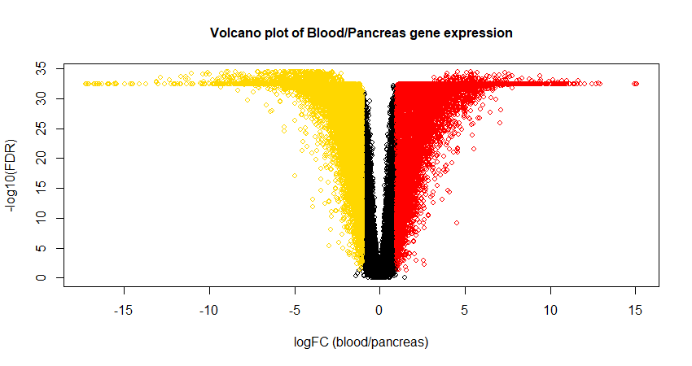
Outline
Download and prepare data
Import to RStudio
Preprocessing:
Load (and install) libraries
Tidy gene expression tables, prepare metadata tables
Filter genes, Normalize.
Differential expression analysis
Apply comparison test across groups
Visualization
PCA - scatterplot
Volcano plot
Heatmap
vs.

Slide 3




Download Data
Search “GTEx Portal” in Google and go into their website (https://www.gtexportal.org/home/)
Go to Downloads > Open Access Data
Bulk tissue expression tab
Under the GTEx Analysis v10 panel, open the “Gene read counts by tissue” tab. You should see a list of several human tissues. Choose any two tissues you are interested in comparing. I chose pancreas and whole blood.
Click the download icon on the right, and save it in some folder you can easily find from RStudio.
I saved it in “Desktop/DEA_Workshop_2025”
Other open source databases you might be interested:
Gene Expression Omnibus
Recount3
The Cancer Genome Atlas (TCGA)(GDC Data Portal)

Slide 4
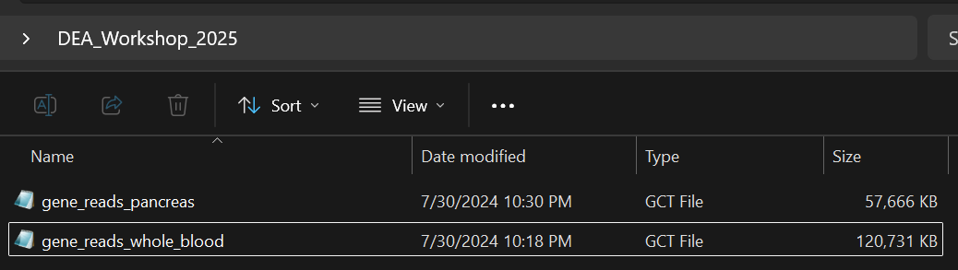
The downloaded files are “.gz”, which means they are compressed folders.
Extract the data (right click, Extract All), and locate them together in the same folder.
You should have two “gene_reads” files that end in “.gct”.
Open one of them to check how a “gct” looks like.
If your computer asks to select a program to open with, just select the Notepad, gct files are just plain text.

Slide 5
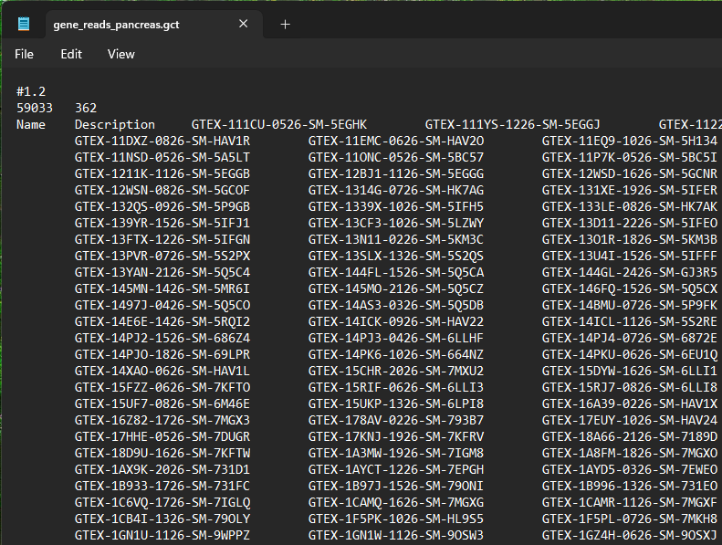
You should see something like this:
The first line starts with a “#”, and indicates a version number.
The second line has two columns.
The first column indicates the number of rows in the file (number of genes).
The second column, the number of columns (number of samples/patients)
The table is so huge we cannot see it all, we are just looking at a snippet of the first 3 lines.
Starting from the 3rd line (which are the column names), we can see “Name”, “Description”, and some GTEX ID’s.
Name: is the Ensembl Gene ID
Description: is the gene symbol
So we have 59k genes and 362 samples in the pancreas dataset.
In whole blood, we have the same 59k genes, and 803 samples!

Slide 6
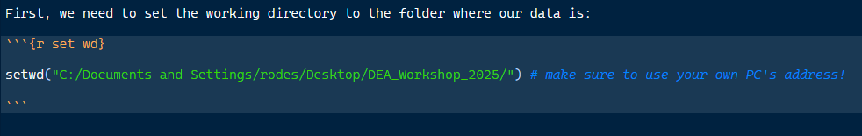
Open RStudio, and open the “.Rmd” file from this workshop session. (I will give it as handout). If you downloaded pancreas and whole blood, you should be able to just run the code and have the same results. If not, you should edit the code to fit your own data.
Also, you must change this address to your own PC!
This is set for my PC so it won’t work in yours!

Slide 7
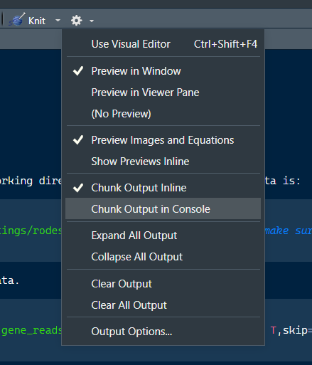
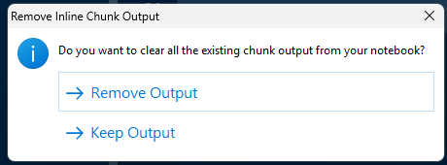
(Optional)
You can set your “Chunk Output in Console”, so that the plots and results we generate are displayed in the “Plots” panel instead of the R Markdown itself.
Click the gear button and change from Inline to Console
It will ask to Keep or Remove Output, click “Remove”

Slide 8
Follow the R Markdown!

Slide 9
What is PCA? How is it calculated? What is variance explained? How to interpret?
Recommended resource:
Josh Starmer’s Stat Quest
https://statquest.org/
Also available in youtube.

Slide 10
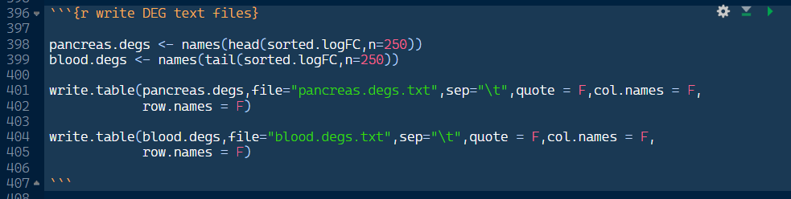
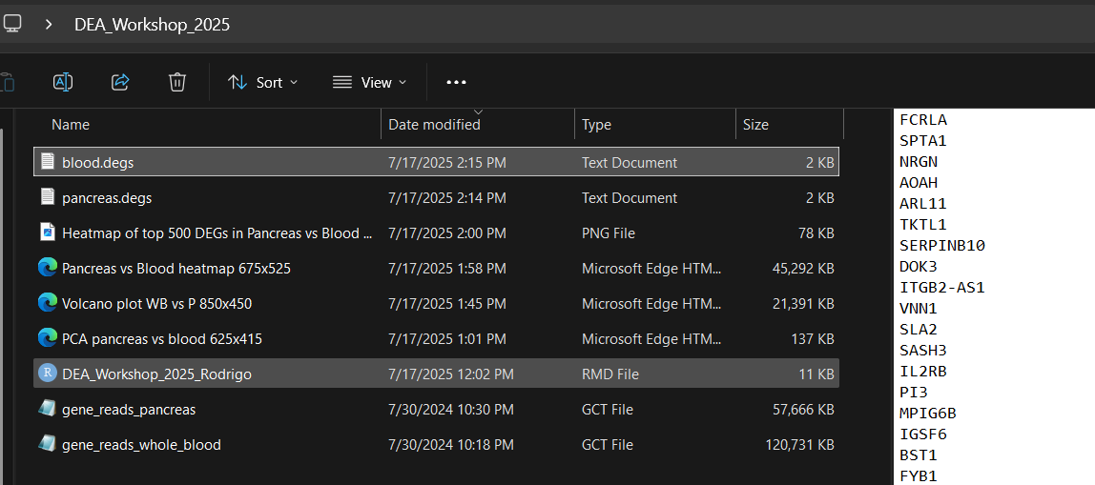
Over-representation Analysis (ORA) using STRING-PPI
Once you reached to this stage, you should have two text files in your working folder, “blood.degs.txt” and “pancreas.degs.txt”
Search string ppi in Google, and go to their website (https://string-db.org/)

Slide 11
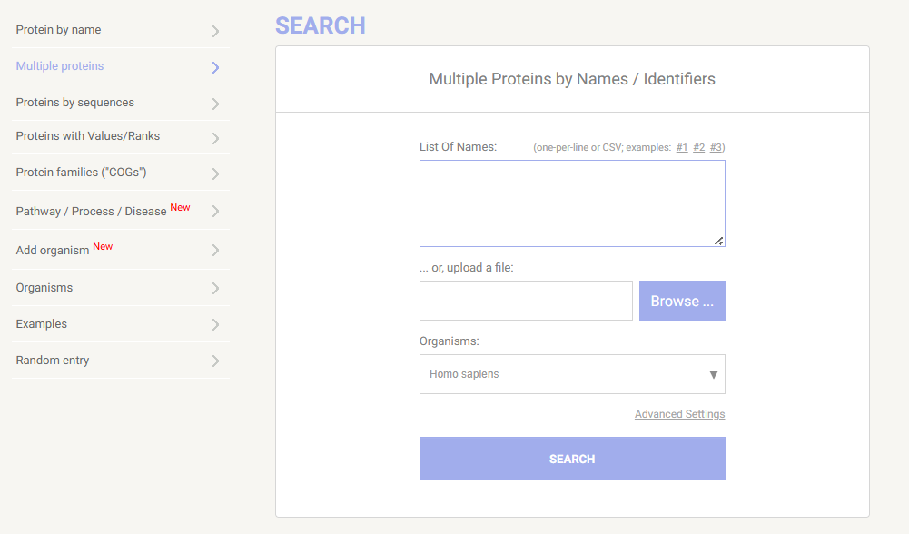
Over-representation Analysis (ORA) using STRING-PPI
Navigate to “Multiple proteins” and you should see this window.
Click “Browse” to upload one of our text files. Make sure that the Organism is “Homo sapiens”. Then click Search.
It will list the genes from our file that matches their database for Homo sapiens. Click “Continue”

Slide 12
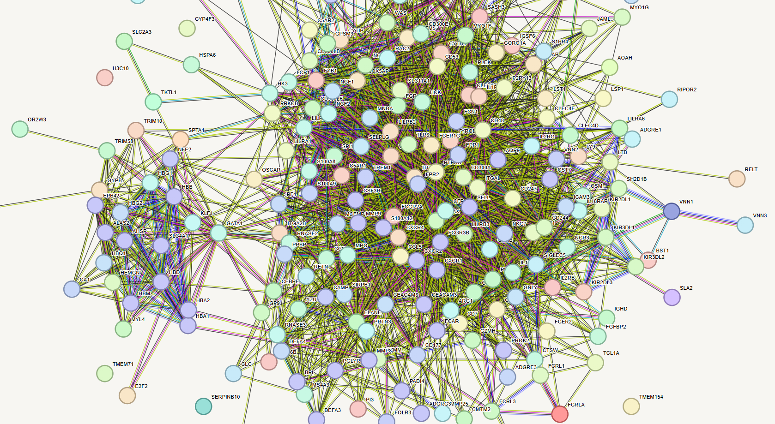
Over-representation Analysis (ORA) using STRING-PPI
It should show a very big and ugly network. This is because we selected 250 genes and most of them matched the reference.
They also seem to interact densely.
Scroll down and go to the “Analysis” tab.

Slide 13
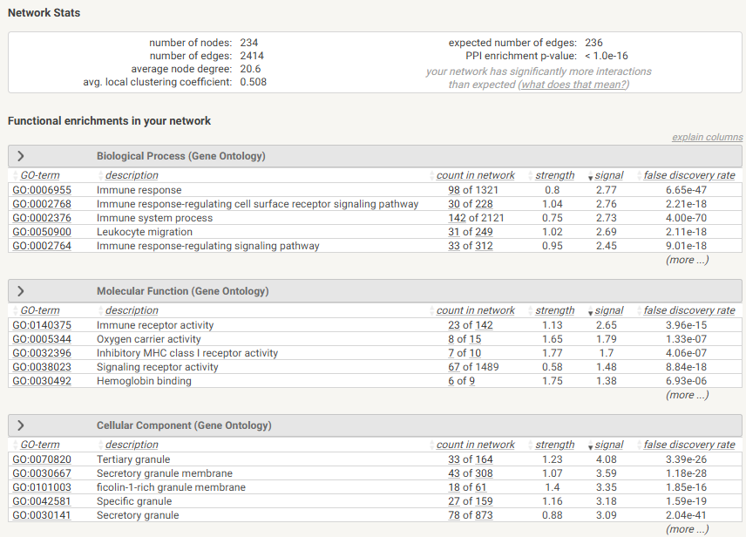
Over-representation Analysis (ORA) using STRING-PPI
This will show you the significant gene sets that resulted from our ORA. The first 3 boxes are from Gene Ontology.
We can see a lot of immune response gene sets, hemoglobin binding, oxygen carriers, secretory granules, etc.
All of these match what we can expect in blood cells!
Red-blood cells,
White blood cells,
Leukocytes
Lymphocytes
Macrophages,
etc...
If you keep scrolling down, you will see more boxes with different annotations.

Slide 14
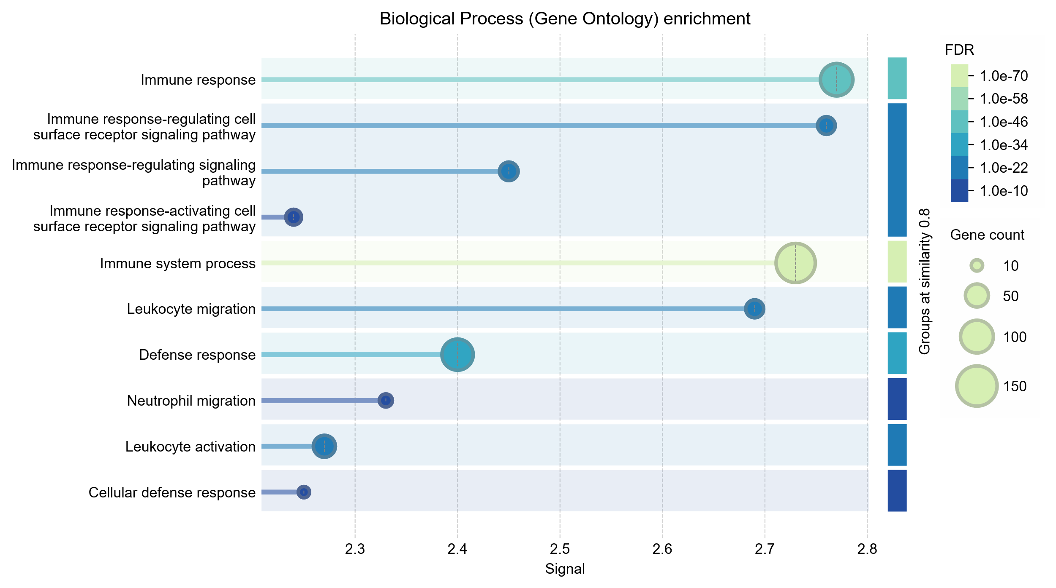
Over-representation Analysis (ORA) using STRING-PPI
At the bottom, you can see a panel where you can generate these nice plots to show the strength of the enrichment, and their FDR values.

Slide 15
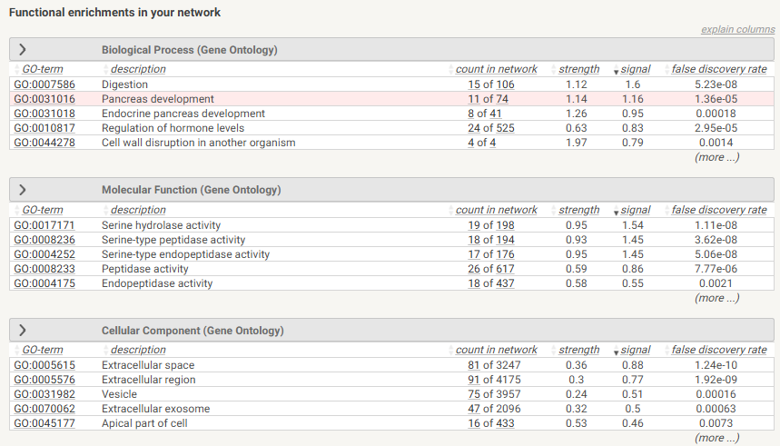
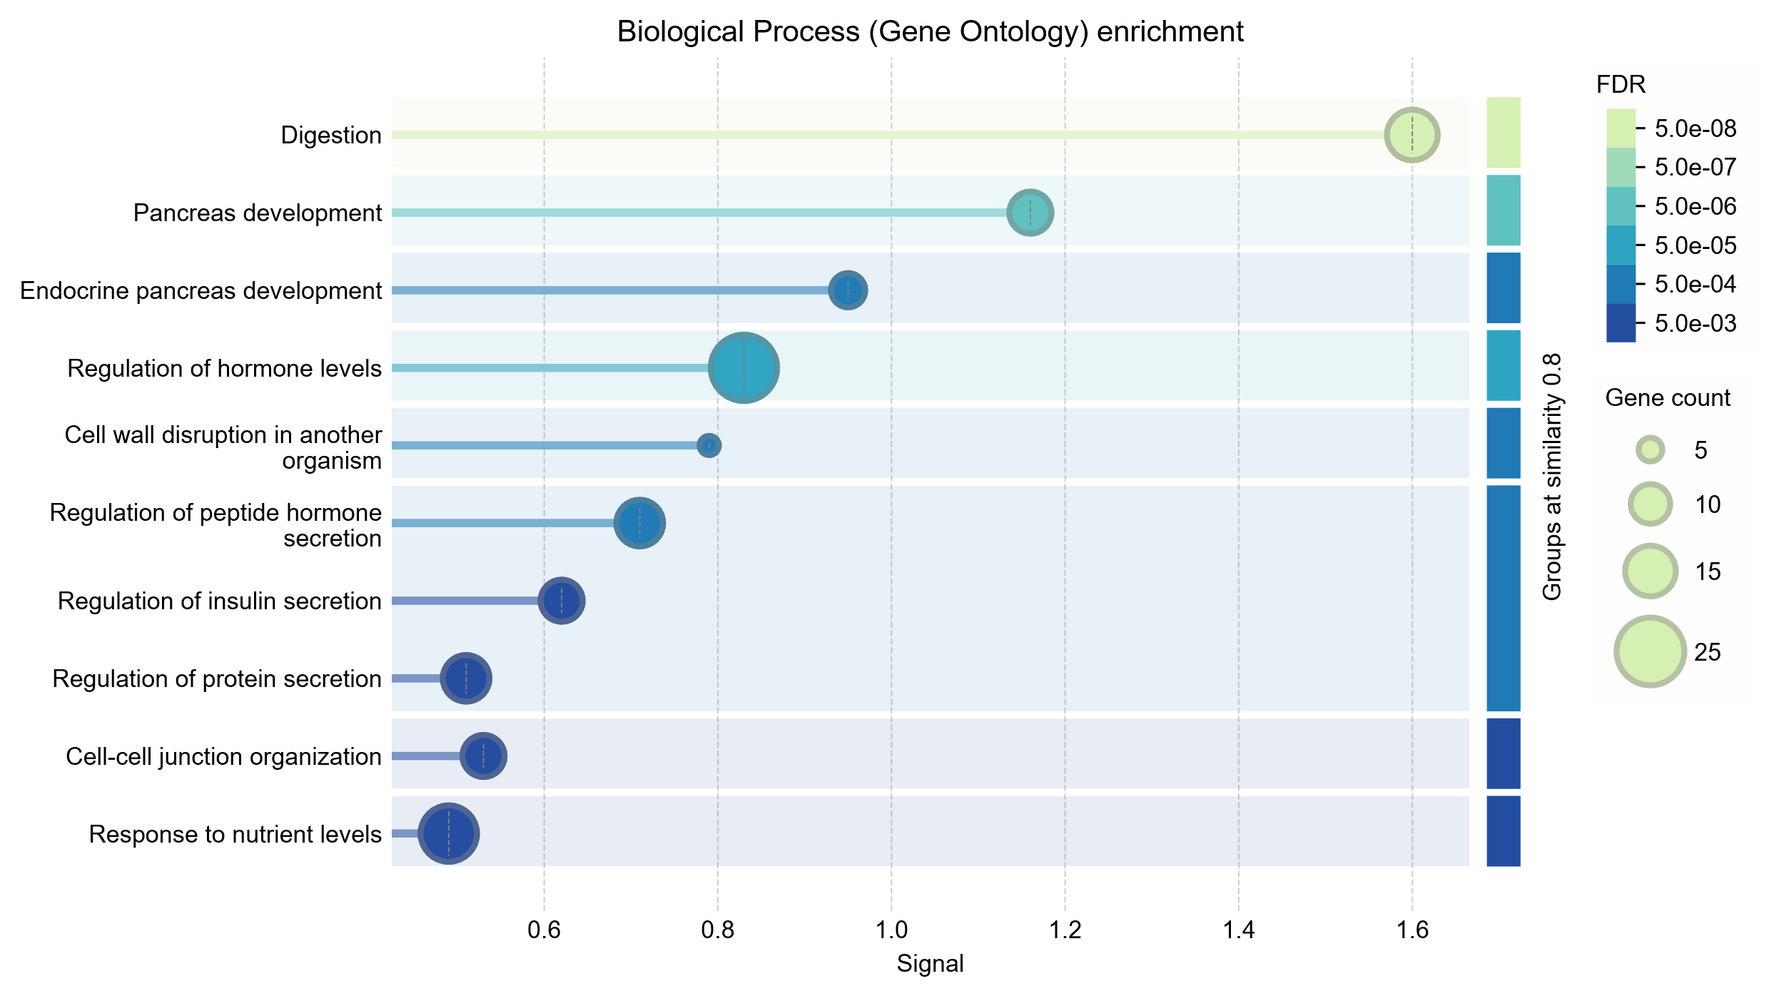
Over-representation Analysis (ORA) using STRING-PPI
Try doing the same with Pancreatic DEGs!

Slide 16
Challenge (optional)
Try using other tissues from GTEx, you will need to edit our code correspondingly.
You can also explore the other mentioned databases, TCGA, GEO, and compare gene expression between diseased and healthy tissues!

Slide 17
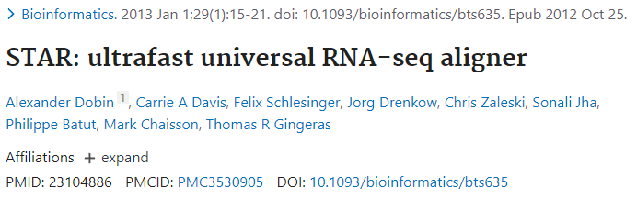
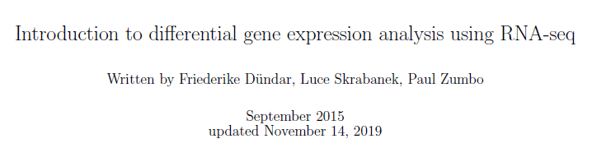
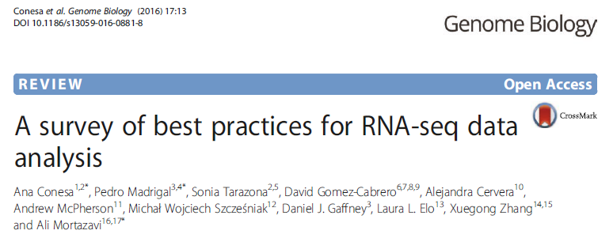
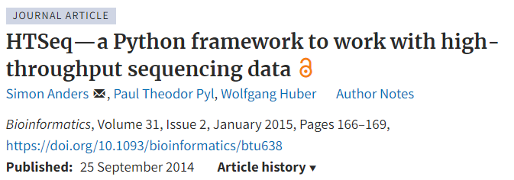
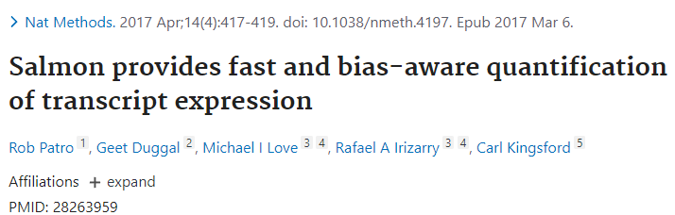
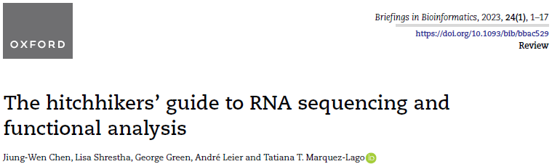
Resources: tutorial, papers & documentation

Slide 18
Thank you for your attention!

